Slide 1
Dirt Bike Racer
Jake Schuenke
Tyler Shelton
Matt Spurr

Slide 2
Requirements
Title Screen to introduce the game
A Main Menu to start the game
A minimum of three distinct levels
An avatar that is represented by a dirt bike with a rider
The ability to maneuver obstacles using arrow key shortcuts
A win state, fail state, and game complete state
Timer to keep track of time spent overall on all levels

Slide 3
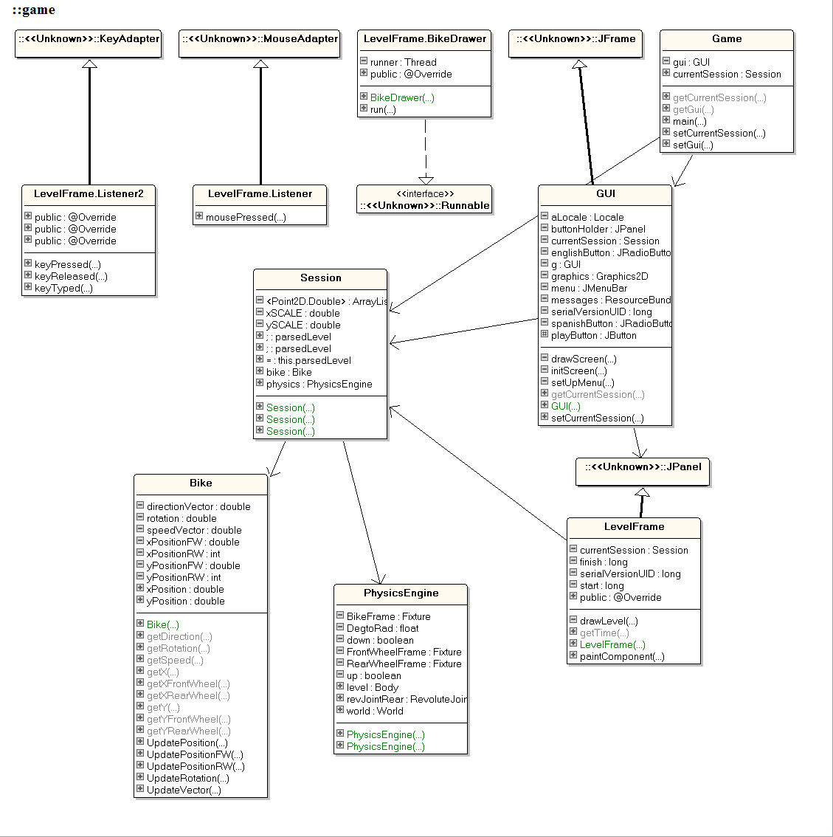
Class Diagram

Slide 4
Project Demonstration Time!

Slide 5
What We Learned
You have to have a very good plan
You have to really understand the tools you use
Thinking about how you are going to test makes it easier to implement

Slide 6
Metrics Used
Percentage of Tests Passed
Afferent Coupling
Efferent Coupling
Method Lines of Code
Depth of Inheritance Tree
Notes:
Metrics
Percentage of Test Passed
This is the average of the percentage of test cases passed each week.
We will track this each week and keep the records in a text doc.
If this metric is high, it means we are meeting our goals and if it is low, we are not.
This will show us how production changes week to week.
Afferent Coupling
The number of packages that depend upon classes within the package.
We’ll use the Metric plugin in eclipse to track this metric.
If this metric is high, it indicates class independence, if it’s low dependence.
We can use this to tell how coupled our overall project is.
Efferent Coupling
The number of packages that the classes in the package depend upon.
We’ll use the Metric plugin in eclipse to track this metric.
If this metric is high, it indicates class dependence, if its low independence.
We can use this to tell how coupled our overall project is.
Method Lines of Code
Lines of code that make up the methods within the project.
We’ll use the Metric plugin in eclipse to track this metric.
This metric is a better indication of how many lines of working code that we have written. compared to just lines of code, which includes comments and headers.
This can be used to measure the overall size or the project and the progress each week.
Depth of Inheritance Tree
The maximum length of a path from a class to a root class in an inheritance structure.
We’ll use the Metric plugin in eclipse to track this metric.
The DIT can affect a lot of things like Re-Usability, Maintainability, and Portability.
We can use this to assess the state of the project and use the information to increase its efficiency.

Slide 7
Metrics Through Time

